Slide 1



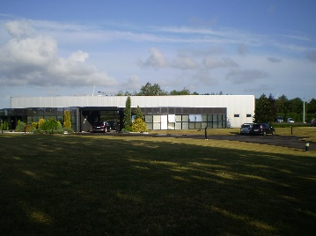
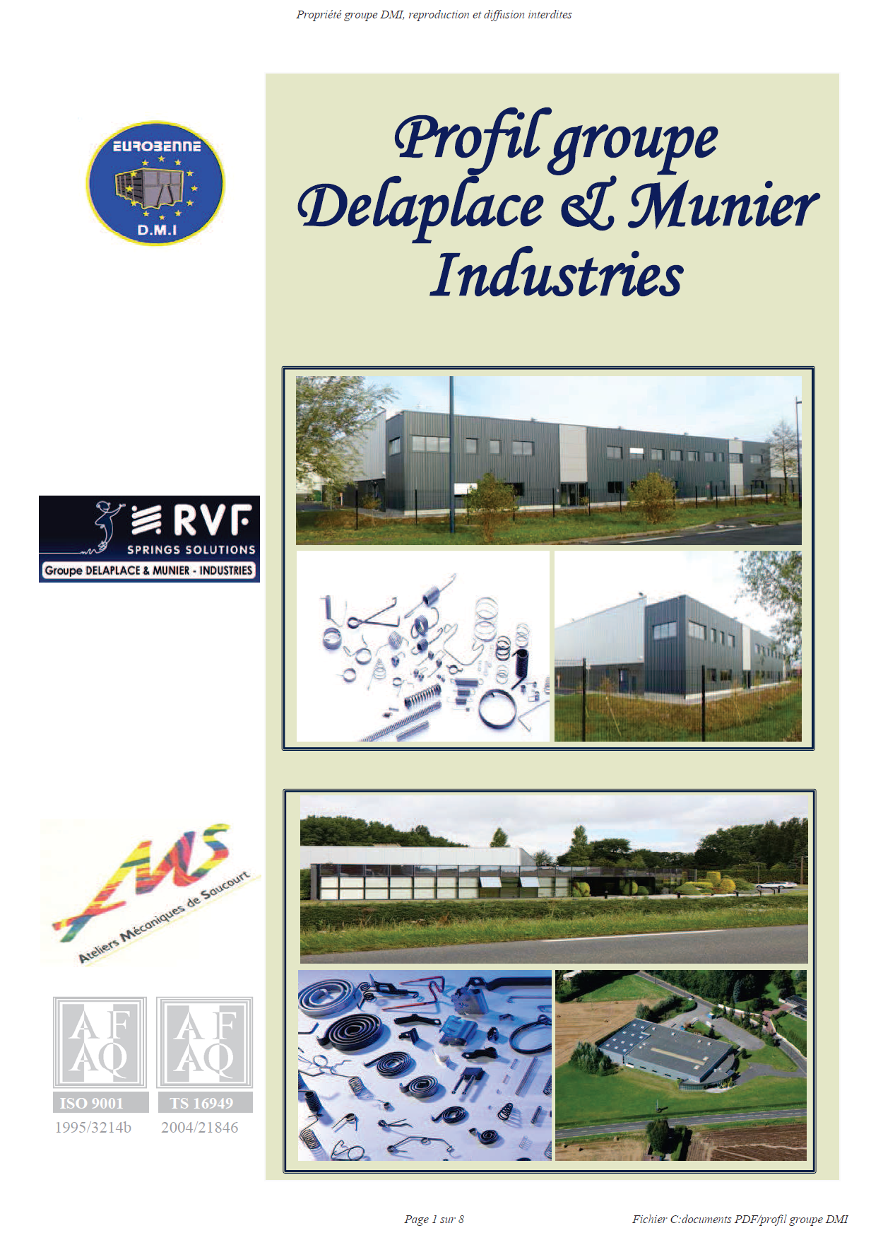
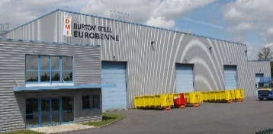
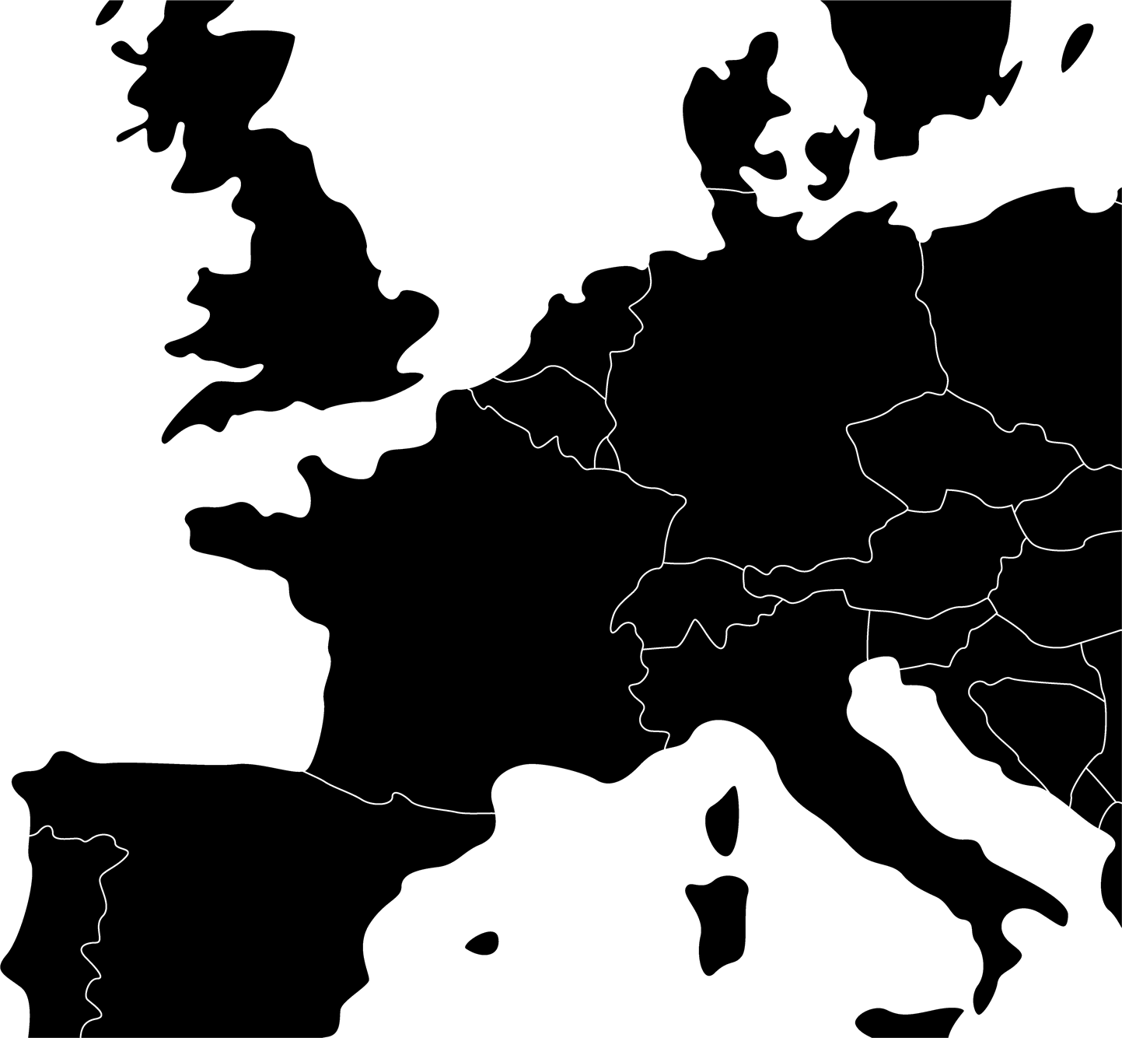
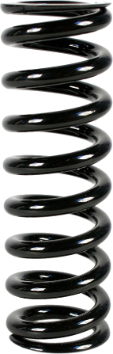
Groupe DMI
Nibas (80)
Wattrelos (59)
St Quentin (02)
Spring & Container Manufacturer
3 factories in northern France
Spring
Department

Slide 2
Groupe DMI side face
Spring Department
AMS
CA : 6 Millions € / an
Effectif : 35
Certification : ISO TS 16949 & ISO 9001
Annual Sales
12 000 000 €
Effectif Total
104 Personnes
Effectif Division Ressorts
70 Personnes
2 Factories
RVF
CA : 3 Millions € / an
Effectif : 35
Certification : ISO 9001

Slide 3
Business Line
Electrical
Equipment
Automotive
Other
B
U
S
I
N
E
S
S
L
I
N
E
50%
15%
35%
Faurecia
Valeo
Coutier
Schneider
ABB
Home appliance
Textile
Construction & Public Works
Fittings

Slide 4
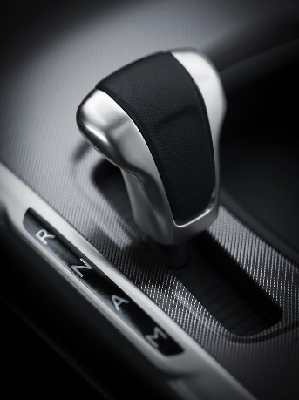
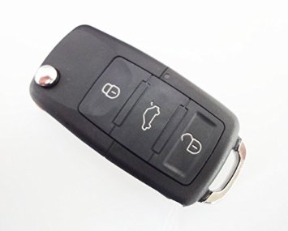
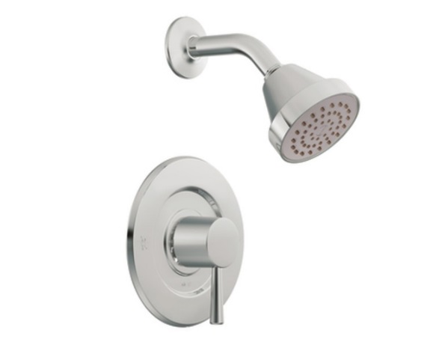
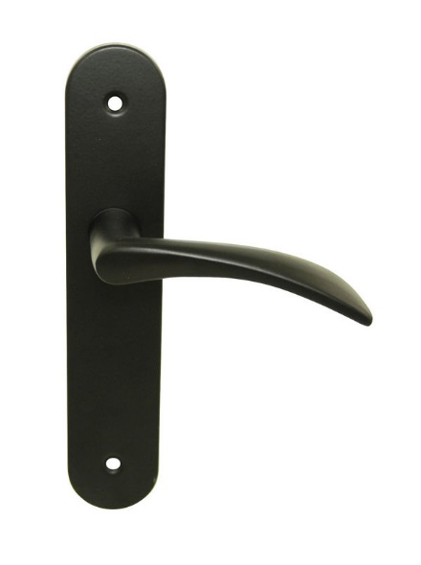
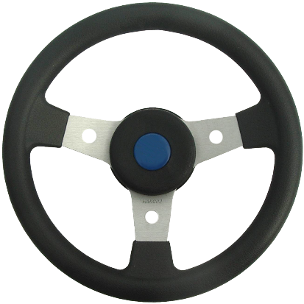
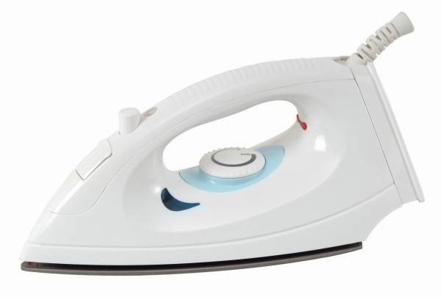
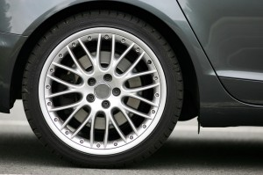

Scope Example
Gear shift spring
Car key spring
Fittings
Door handle spring
Steering spring
Brake spring
Door handle spring
Iron buttons spring

Slide 5
Products Line
0,1 to 3,5 mm
0,1 to 6,0 mm
0,25 to 6,0 mm
Width 2 to 20 mm
Thickness 0,2 to 5 mm
0,1 to 10,0 mm
Compression Spring
Tension Spring
Flat lead spring
Torsion Spring
Formed wire

Slide 6

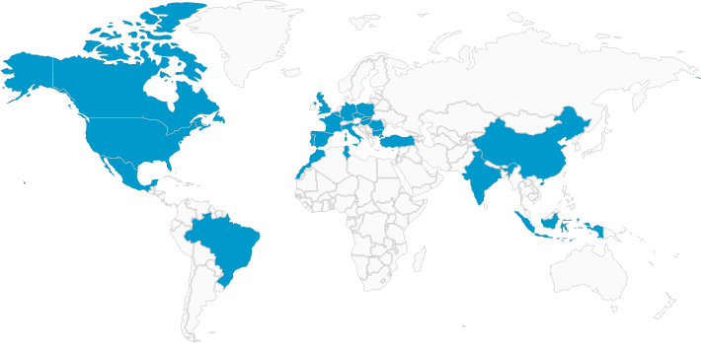
La Division Ressorts c’est :
Contact :
3 000 000 springs manufactured by days
Over 100 numerical machines
Numerical control
Worldwide exports
Phone : 03-22-30-41-90
Mail : contact.ams@ressorts.net
WebSite : www.ams-ressorts.com
RVF Ressorts
Phone : 03-20-70-08-47
Mail : contact@rvf.com
WebSite : www.rvf.com

